Slide 1
Project Presentation of APC (Spring-boot)
On
Finance Management System
Project ID : APC-2015
Kunal Bhatia – 2310990638
Rishu – 2310991350
Ravneet Kaur– 2310991188
Priyanshu - 2310991183
Supervised By
Mr. M. Imran
Department of Computer Science and Engineering, Chitkara University, Punjab

Slide 2
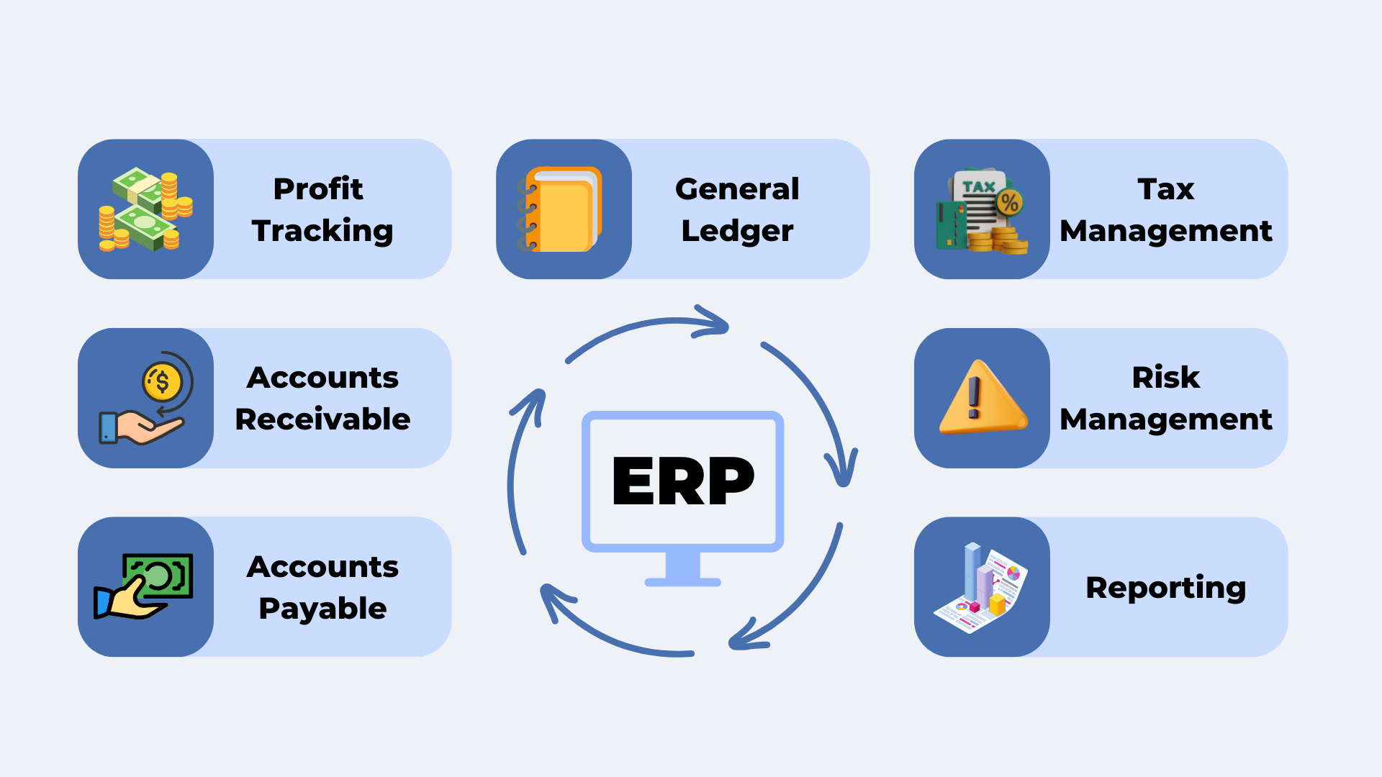
Introduction
The Finance Management System (FMS) is a web-based application designed to help individuals and organizations track, manage, and optimize their financial activities. It provides a centralized platform to record income, expenses, investments, and budgets efficiently.
This system simplifies the process of financial planning by providing real-time analytics, transaction tracking, and report generation.
2

Slide 3
Problem Statement
Managing finances manually or through spreadsheets can be:
Time-consuming – Hard to track multiple transactions across categories.
Error-prone – Manual data entry leads to calculation errors.
Unorganized – Lack of proper reporting and categorization.
Lack of insights – No visualization of spending patterns or financial health.
Data loss risk – No centralized secure storage.
Problem: Users need a centralized system to efficiently manage their income, expenses, and savings while providing insights and reports to make data-driven financial decisions.

Slide 4

Advantages
Centralized Data Storage – All financial data is securely stored in one database (MySQL).
Automation – Automated calculations for budgets, savings, and reports.
Better Decision-Making – Real-time analytics help users plan expenses.
User-Friendly Interface – Dynamic UI built with Thymeleaf.
Secure and Scalable – Uses Spring Security for authentication and scalable architecture with Spring Boot.
Cross-Platform Accessibility – Accessible via web browsers on any device.
Customizable Categories – Income and expense categories can be tailored to user needs.

Slide 5
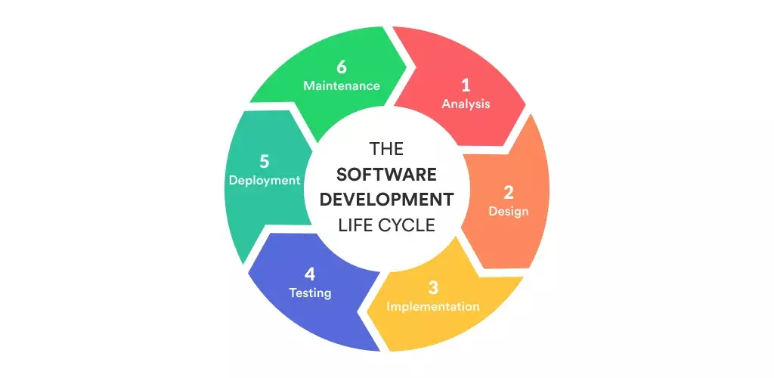
SDLC Models

Slide 6
Key Features and Functionality
User Management
Register, Login, Logout (Spring Security).
Role-based access (Admin, User).
Expense & Income Tracking
Add, edit, delete, and view income or expense records.
Categorize transactions (e.g., food, bills, rent, salary).
Budget Management
Set monthly budgets.
Alerts when expenses exceed the budget.
Report Generation
Generate daily, weekly, or monthly financial reports.
Export reports in PDF/Excel formats.
Visual representation of data with charts/graphs.
Dashboard
Real-time summary of total income, expenses, and savings.
Display analytics using Thymeleaf templates.
Admin Panel
Manage all users and transactions.
CRUD operations for categories and user data.

Slide 7
Technical Details
Aspect | Technology Used
Frontend | Thymeleaf, HTML5, CSS3, Bootstrap
Backend | Spring Boot (REST APIs, Business Logic)
Database | MySQL
ORM | Hibernate (JPA)
Dependency Management | Maven
Security | Spring Security (JWT / Session-based Auth)
Architecture | MVC (Model-View-Controller)
Deployment | Apache Tomcat / Docker Container
Project Flow:
User Interaction → via Thymeleaf templates.
Controller Layer (Spring MVC) → Handles HTTP requests.
Service Layer → Business logic like expense calculations.
Repository Layer (Hibernate JPA) → Database CRUD operations.
MySQL Database → Persistent data storage.

Slide 8
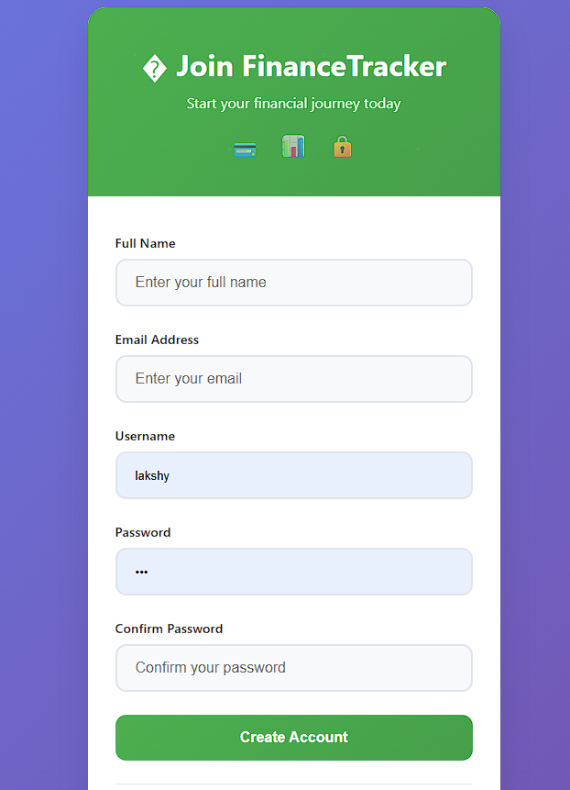
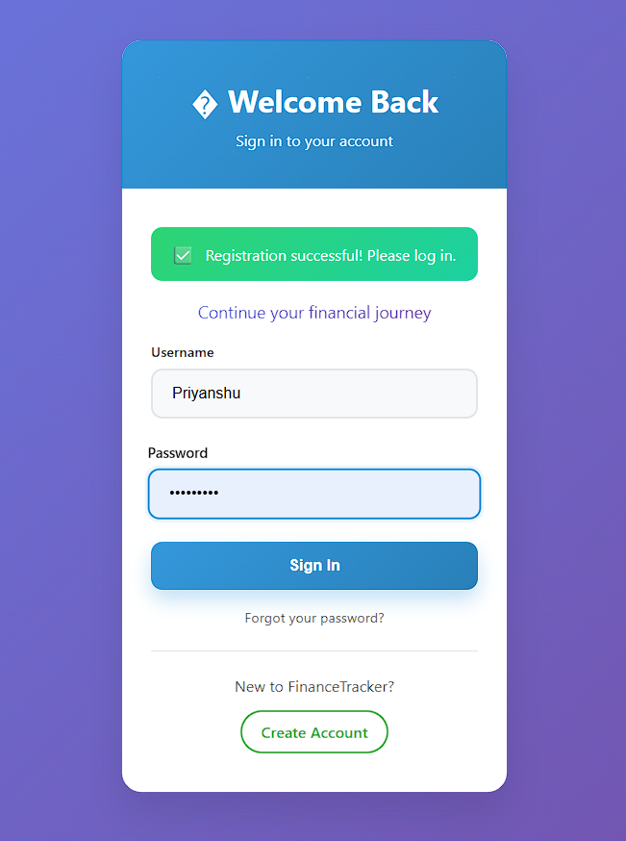
Snapshots

Slide 9
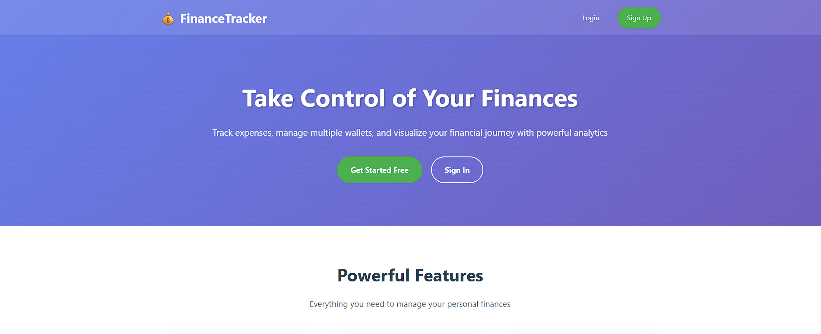

Snapshots

Slide 10
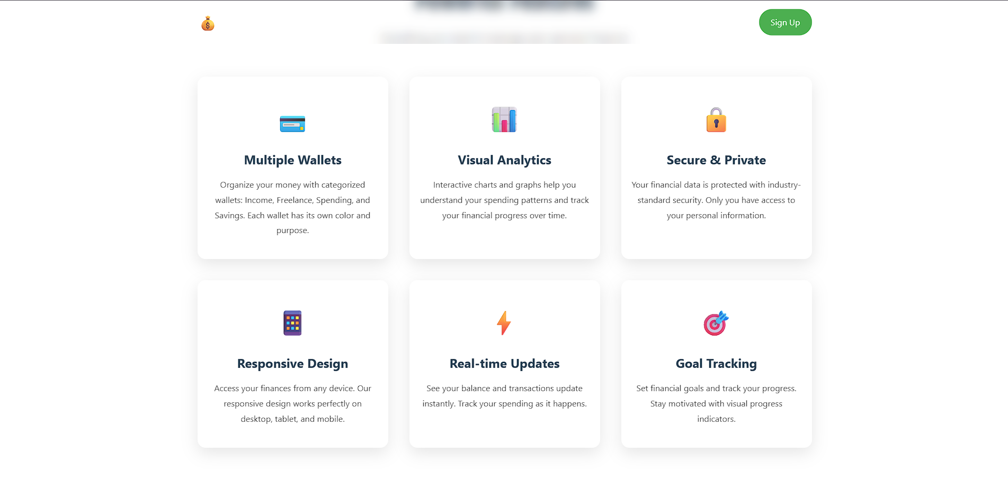
Snapshots

Slide 11
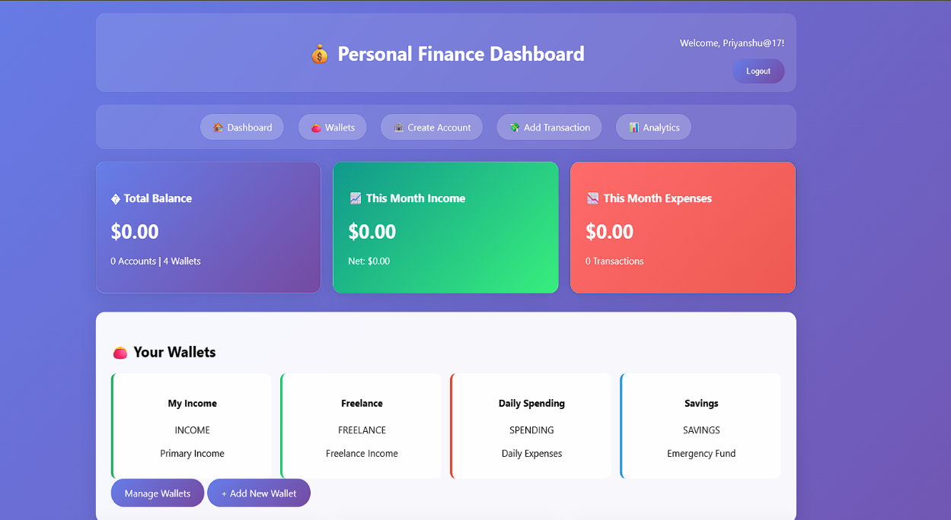
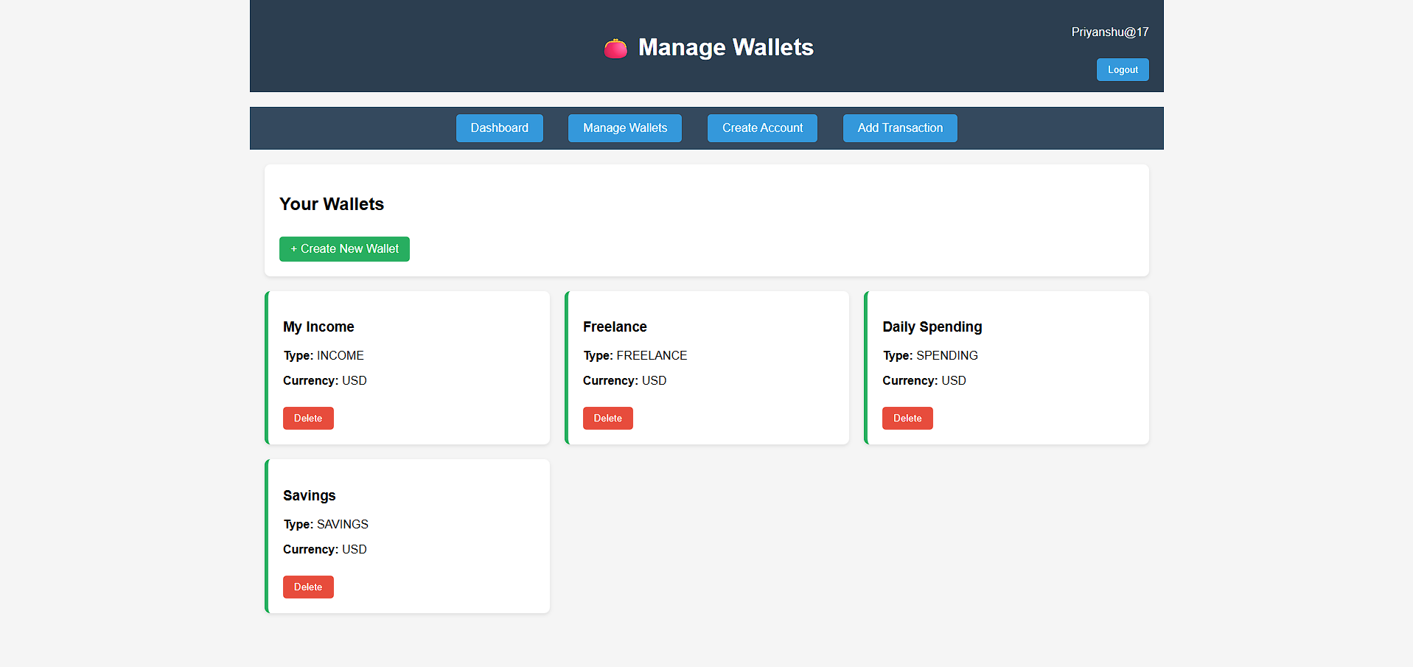
Snapshots

Slide 12
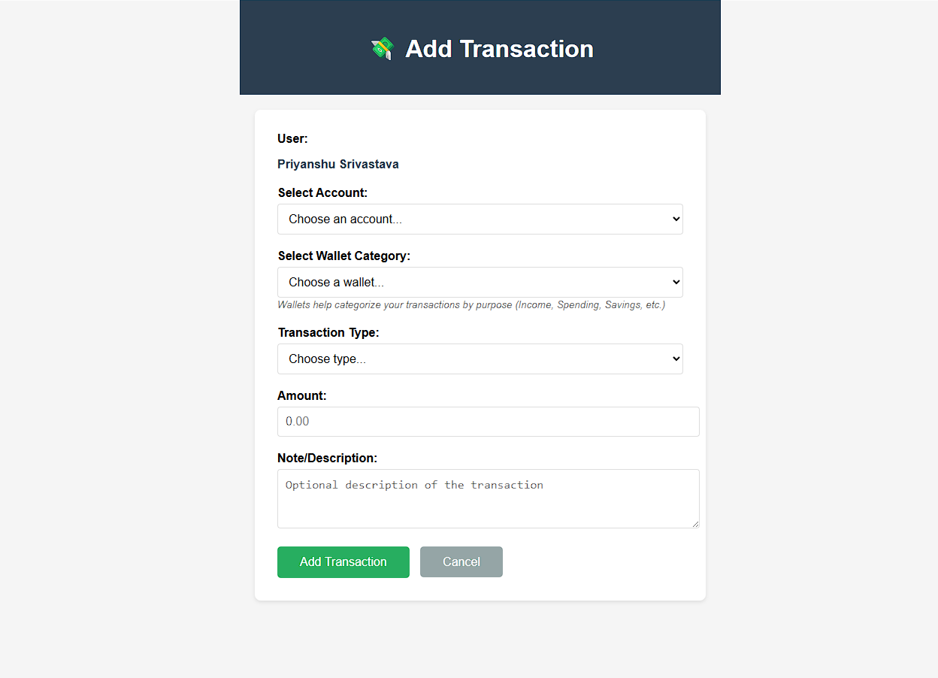
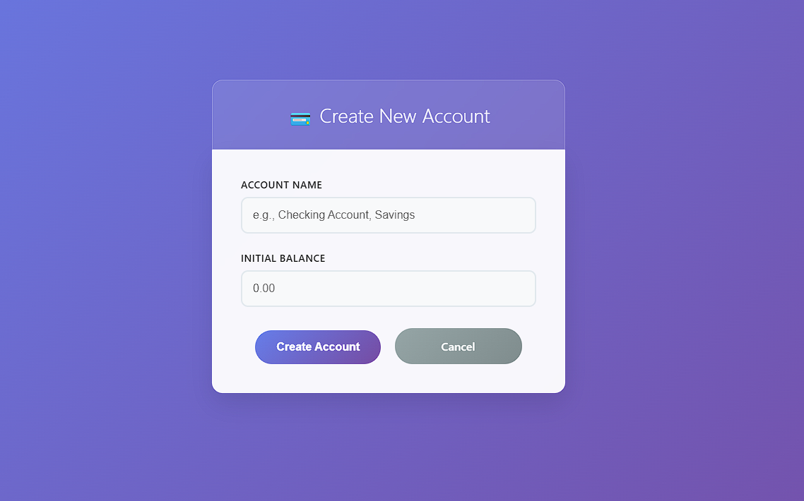
Snapshots

Slide 13
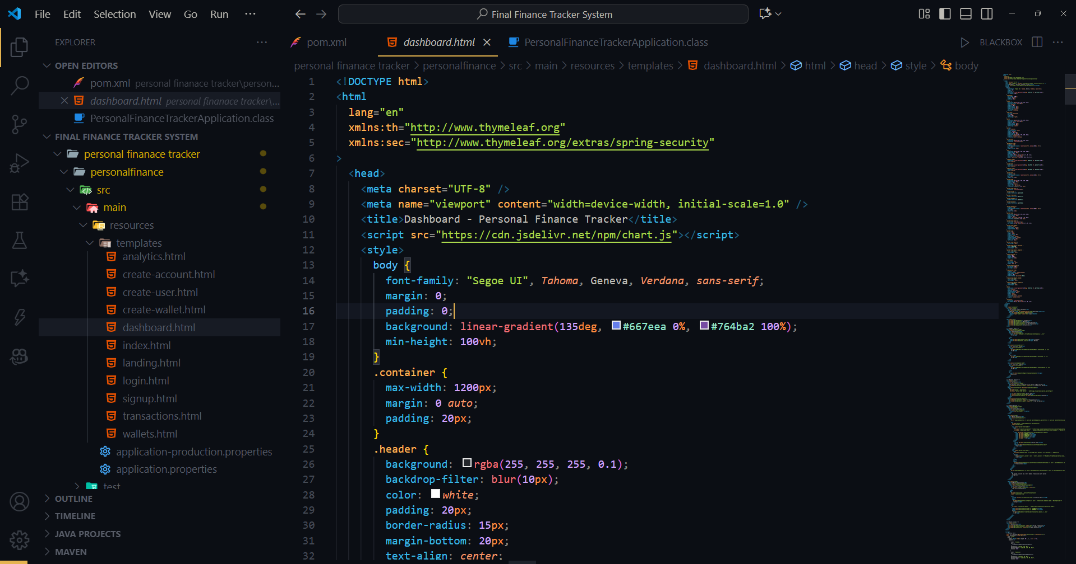
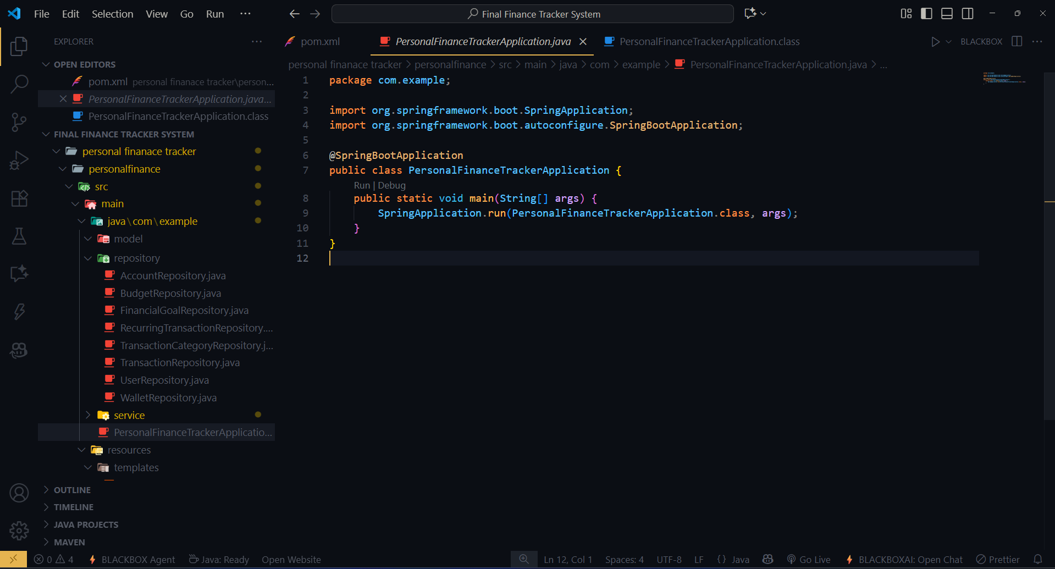
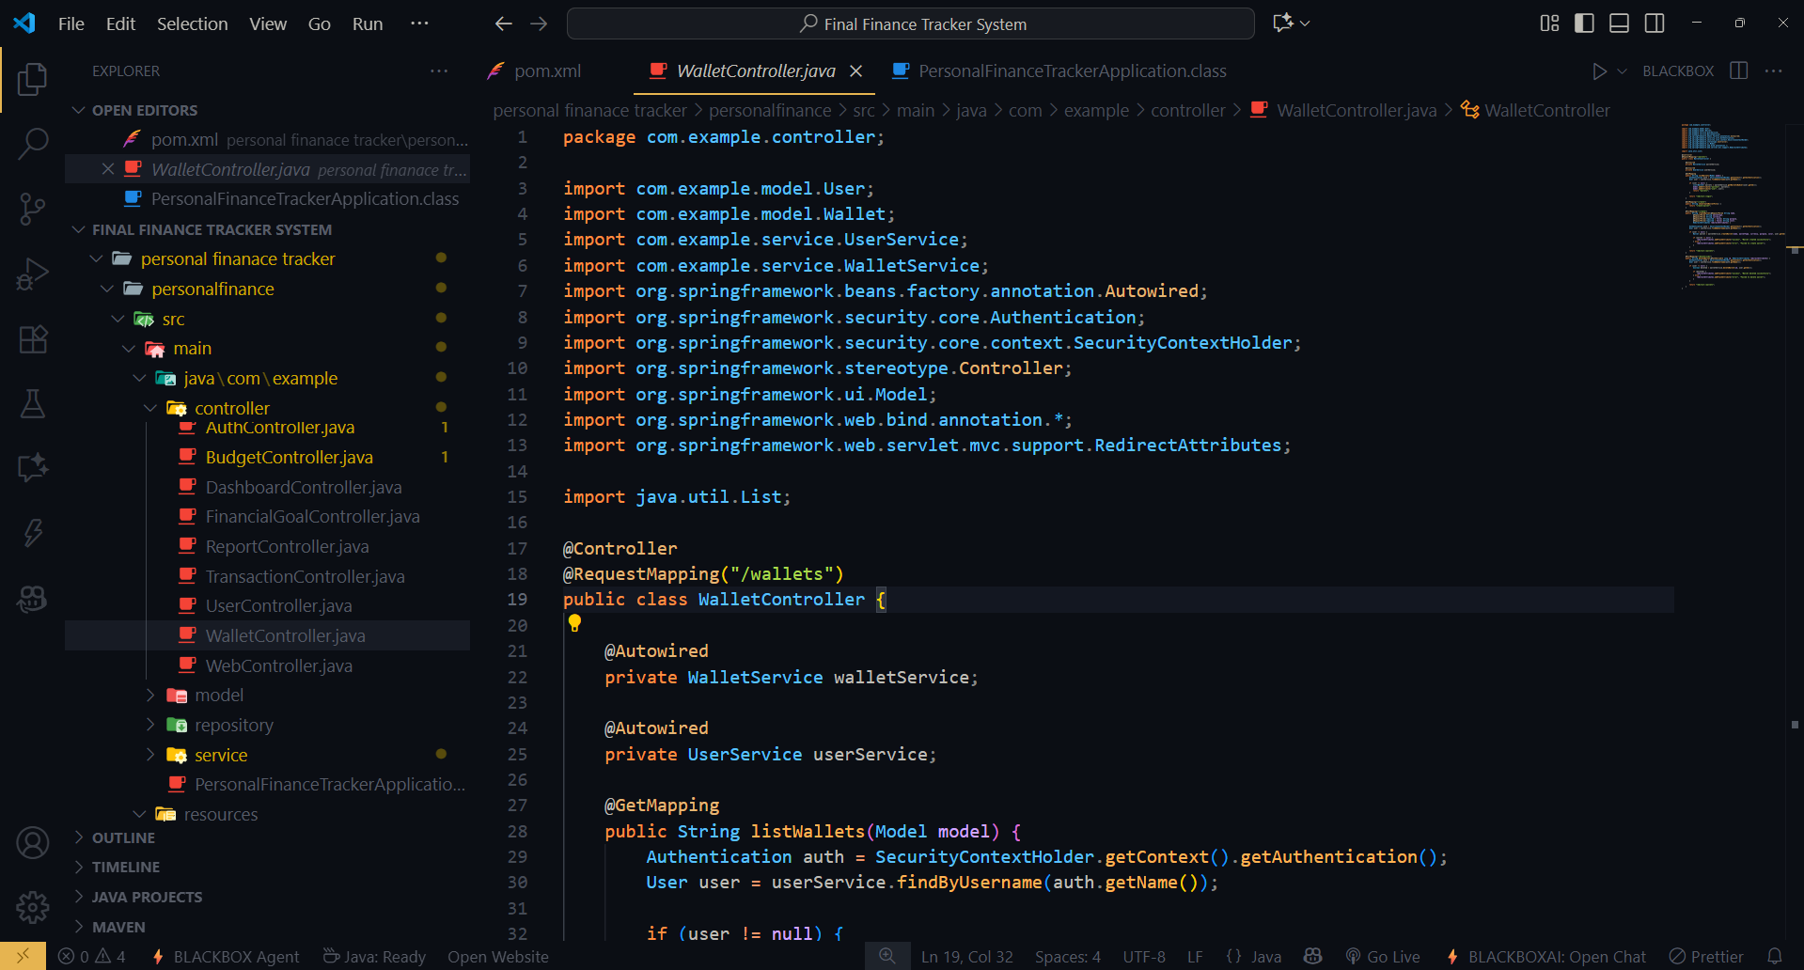
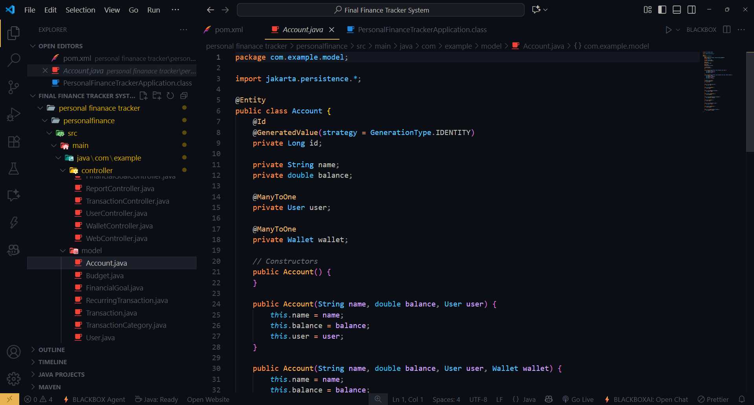
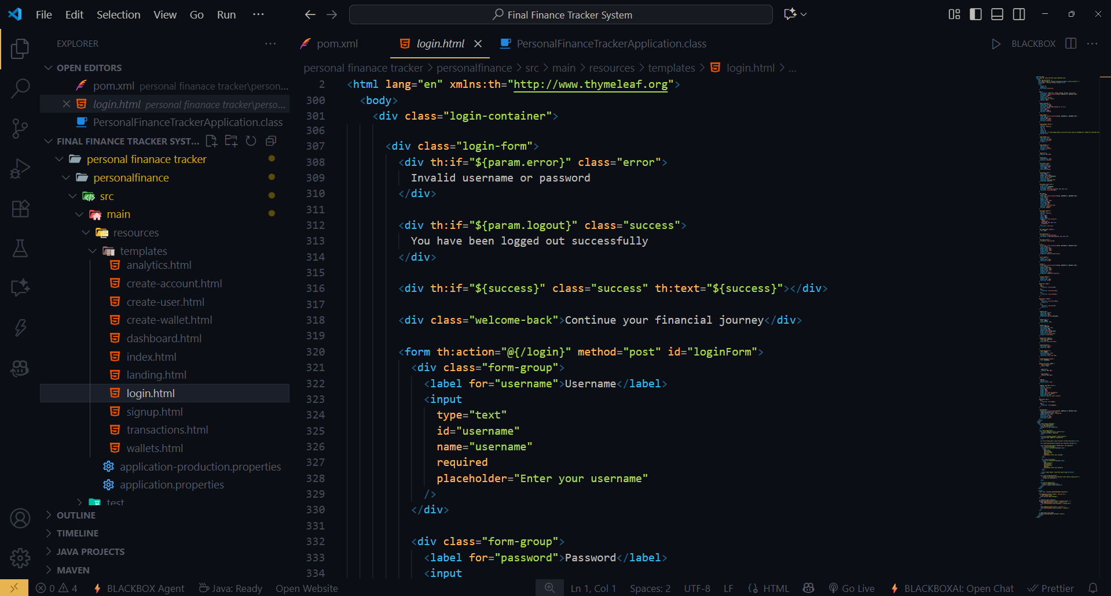
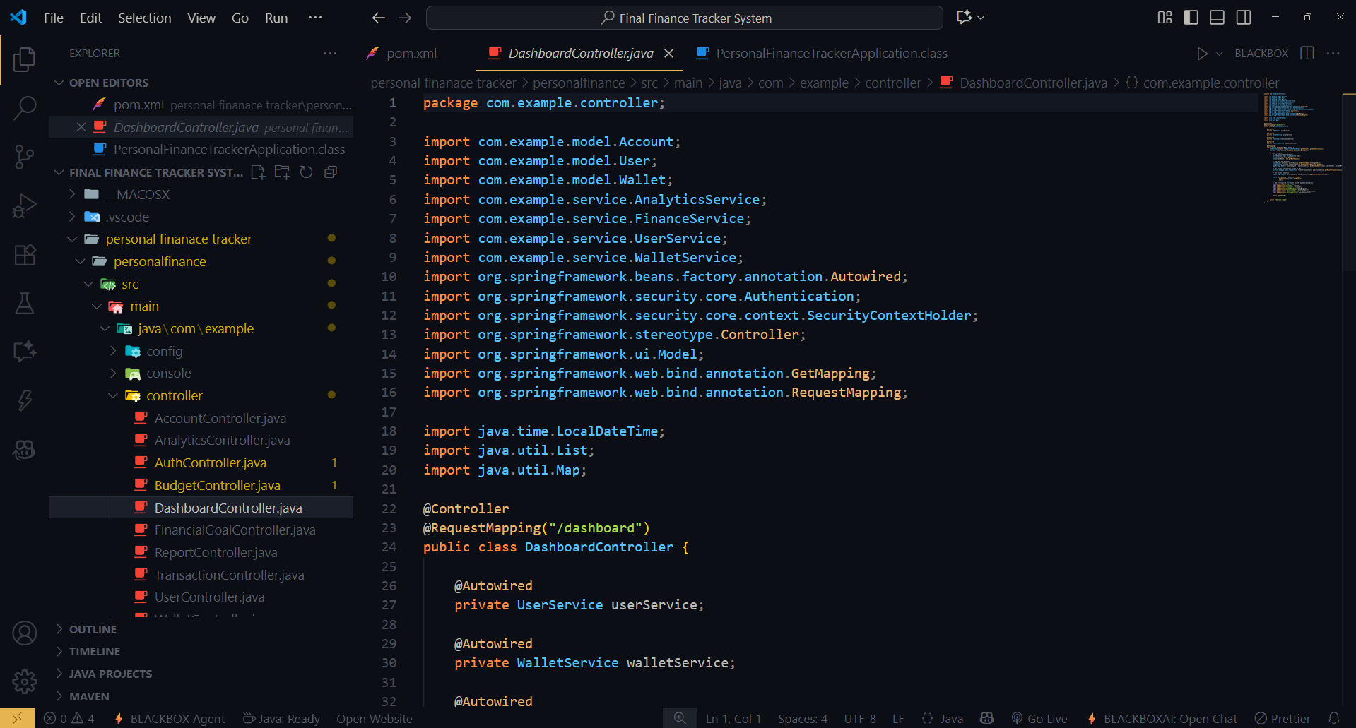
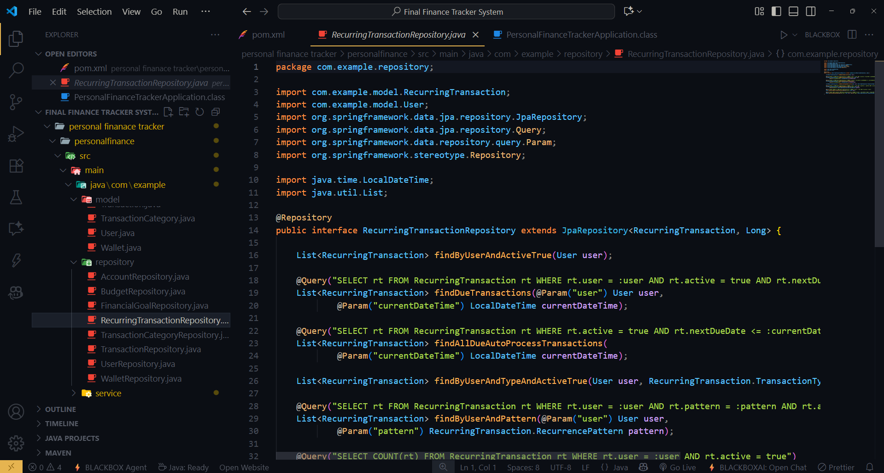
Code Snapshots

Slide 14
Code Snapshots

Slide 15
Code Snapshots

Slide 16
Code Snapshots

Slide 17
Future Scope
Mobile App Integration Build an Android/iOS app connected to the same backend APIs.
AI-Powered Insights Predictive analytics for future expense trends and savings suggestions.
Payment Gateway Integration Directly manage bills and payments through the platform.
Multi-Currency Support For international users handling different currencies.
Cloud Deployment Host on AWS/Azure for global access and scalability.
Blockchain Integration For secure and transparent transaction management.
Data Visualization Dashboard Advanced charts and KPIs using libraries like Chart.js or D3.js.

Slide 18
Thank You
18

